Slide 1

Macroeconomics of National Income Accounting
Swagat Kishore Mishra
LECTURE 30

Slide 2
Outline
National Income Estimation
Macroeconomic parameters

Slide 3
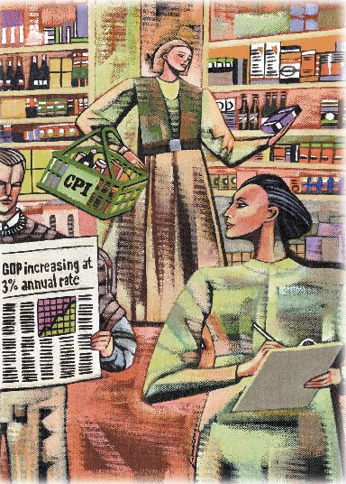
Measuring a Nation’s Income

Slide 4
Microeconomics
Microeconomics is the study of how individual households and firms make decisions and how they interact with one another in markets.

Slide 5
Macroeconomics
Macroeconomics is the study of the economy as a whole.
Its goal is to explain the economic changes that affect many households, firms, and markets at once.

Slide 6
Macroeconomics
Macroeconomics answers questions like the following:
Why is average income high in some countries and low in others?
Why do prices rise rapidly in some time periods while they are more stable in others?
Why do production and employment expand in some years and contract in others?

Slide 7
The Economy’s Income and Expenditure
When judging whether the economy is doing well or poorly, it is natural to look at the total income that everyone in the economy is earning.

Slide 8
The Economy’s Income and Expenditure
For an economy as a whole, income must equal expenditure because:
Every transaction has a buyer and a seller.
Every dollar of spending by some buyer is a dollar of income for some seller.

Slide 9
Gross Domestic Product
Gross domestic product (GDP) is a measure of the income and expenditures of an economy.
It is the total market value of all final goods and services produced within a country in a given period of time.

Slide 10
The Circular-Flow Diagram
The equality of income and expenditure can be illustrated with the circular-flow diagram.

Slide 11
The Circular-Flow Diagram
Revenue
Market for
Goods
and Services
Spending
Goods & Services sold
Goods & Services bought
Firms
Households
Inputs for production
Labor, land, and capital
Market for
Factors
of Production
Wages, rent, and profit
Income
Notes:
7

Slide 12
The Measurement of GDP
GDP is the market value of all final goods and services produced within a country in a given period of time.

Slide 13
The Measurement of GDP
Output is valued at market prices.
It records only the value of final goods, not intermediate goods (the value is counted only once).
It includes both tangible goods (food, clothing, cars) and intangible services (haircuts, housecleaning, doctor visits).

Slide 14
The Measurement of GDP
It includes goods and services currently produced, not transactions involving goods produced in the past.
It measures the value of production within the geographic confines of a country.

Slide 15
The Measurement of GDP
It measures the value of production that takes place within a specific interval of time, usually a year or a quarter (three months).

Slide 16
What Is Counted in GDP?
GDP includes all items produced in the economy and sold legally in markets.

Slide 17
What Is Not Counted in GDP?
GDP excludes most items that are produced and consumed at home and that never enter the marketplace.
It excludes items produced and sold illicitly, such as illegal drugs.

Slide 18
Other Measures of Income
Gross National Product (GNP)
Net National Product (NNP)
National Income
Personal Income
Disposable Personal Income

Slide 19
Gross National Product
Gross national product (GNP) is the total income earned by a nation’s permanent residents (called nationals).
It differs from GDP by including income that our citizens earn abroad and excluding income that foreigners earn here.

Slide 20
Net National Product (NNP)
Net National Product (NNP) is the total income of the nation’s residents (GNP) minus losses from depreciation.
Depreciation is the wear and tear on the economy’s stock of equipment and structures.

Slide 21
National Income
National Income is the total income earned by a nation’s residents in the production of goods and services.
It differs from NNP by excluding indirect business taxes (such as sales taxes) and including business subsidies.

Slide 22
Personal Income
Personal income is the income that households and non corporate businesses receive.
Unlike national income, it excludes retained earnings, which is income that corporations have earned but have not paid out to their owners.
In addition, it includes household’s interest income and government transfers.

Slide 23
Disposable Personal Income
Disposable personal income is the income that household and noncorporate businesses have left after satisfying all their obligations to the government.
It equals personal income minus personal taxes and certain nontax payments.

Slide 24
The Components of GDP
GDP (Y ) is the sum of the following:
Consumption (C)
Investment (I)
Government Purchases (G)
Net Exports (NX)
Y = C + I + G + NX

Slide 25
The Components of GDP
Consumption (C):
The spending by households on goods and services, with the exception of purchases of new housing.
Investment (I):
The spending on capital equipment, inventories, and structures, including new housing.

Slide 26
The Components of GDP
Government Purchases (G):
The spending on goods and services by local, state, and federal governments.
Does not include transfer payments because they are not made in exchange for currently produced goods or services.
Net Exports (NX):
Exports minus imports.

Slide 27
GDP and Its Components (1998)

Slide 28
GDP and Its Components (1998)

Slide 29
GDP and Its Components (1998)
Consumption
68 %

Slide 30
GDP and Its Components (1998)
Investment
16%
Consumption
68 %

Slide 31
GDP and Its Components (1998)
Government
Purchases
18%
Investment
16%
Consumption
68 %

Slide 32
GDP and Its Components (1998)
Government Purchases
18%
Investment
16%
Net Exports
-2 %
Consumption
68 %

Slide 33
Real versus Nominal GDP
Nominal GDP values the production of goods and services at current prices.
Real GDP values the production of goods and services at constant prices.

Slide 34
Real versus Nominal GDP
An accurate view of the economy requires adjusting nominal to real GDP by using the GDP deflator.

Slide 35
GDP Deflator
The GDP deflator measures the current level of prices relative to the level of prices in the base year.
It tells us the rise in nominal GDP that is attributable to a rise in prices rather than a rise in the quantities produced.

Slide 36
GDP Deflator
The GDP deflator is calculated as follows:

Slide 37
Converting Nominal GDP to Real GDP
Nominal GDP is converted to real GDP as follows:

Slide 38
Real and Nominal GDP

Slide 39
Real and Nominal GDP

Slide 40
Real and Nominal GDP

Slide 41
Real and Nominal GDP

Slide 42
Real GDP in the United States
Billions of 1992 Dollars
(Periods of falling real GDP)
8,000
7,000
6,000
5,000
4,000
3,000
1970
1975
1980
1985
1990
1995
2000

Slide 43
GDP and Economic Well-Being
GDP is the best single measure of the economic well-being of a society.
GDP per person tells us the income and expenditure of the average person in the economy.

Slide 44
GDP and Economic Well-Being
Higher GDP per person indicates a higher standard of living.
GDP is not a perfect measure of the happiness or quality of life, however.

Slide 45
GDP and Economic Well-Being
Some things that contribute to well-being are not included in GDP.
The value of leisure.
The value of a clean environment.
The value of almost all activity that takes place outside of markets, such as the value of the time parents spend with their children and the value of volunteer work.

Slide 46
GDP, Life Expectancy, and Literacy

Slide 47
Summary
Because every transaction has a buyer and a seller, the total expenditure in the economy must equal the total income in the economy.
Gross Domestic Product (GDP) measures an economy’s total expenditure on newly produced goods and services and the total income earned from the production of these goods and services.

Slide 48
Summary
GDP is the market value of all final goods and services produced within a country in a given period of time.
GDP is divided among four components of expenditure: consumption, investment, government purchases, and net exports.

Slide 49
Summary
Nominal GDP uses current prices to value the economy’s production. Real GDP uses constant base-year prices to value the economy’s production of goods and services.
The GDP deflator--calculated from the ratio of nominal to real GDP--measures the level of prices in the economy.

Slide 50
Summary
GDP is a good measure of economic well-being because people prefer higher to lower incomes.
It is not a perfect measure of well-being because some things, such as leisure time and a clean environment, aren’t measured by GDP.

Slide 51
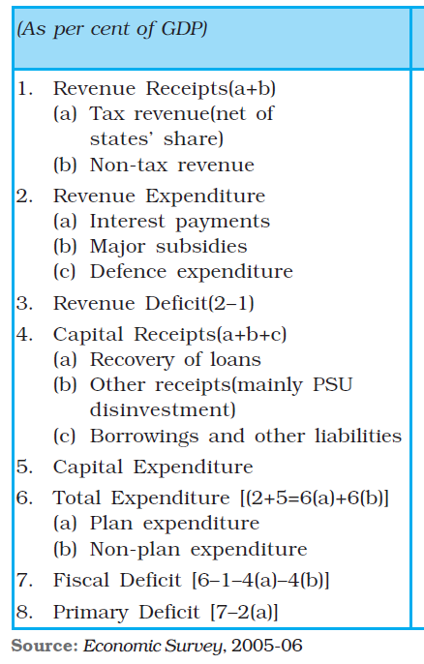
Revenue Deficit: The revenue deficit refers to the excess of government’s revenue expenditure over revenue receipts Revenue deficit = Revenue expenditure – Revenue receipts
Fiscal Deficit: Fiscal deficit is the difference between the government’s total expenditure and its total receipts excluding borrowing Gross fiscal deficit = Total expenditure – (Revenue receipts + Non-debt creating capital receipts)
Gross fiscal deficit = Net borrowing at home + Borrowing from RBI + Borrowing from abroad
Gross primary deficit = Gross fiscal deficit – net interest liabilities

Slide 52
One of Keynes’s main ideas in The General Theory of Employment, Interest and Money was that government fiscal policy should be used to stabilize the level of output and employment. Through changes in its expenditure and taxes, the government attempts to increase output and income and seeks to stabilize the ups and downs in the economy.
In the process, fiscal policy creates a surplus (when total receipts exceed expenditure) or a deficit budget (when total Introductory Macroeconomics expenditure exceed receipts) rather than a balanced budget (when expenditure equals receipts).

Slide 53



The government directly affects the level of equilibrium income in two specific ways – government purchases of goods and services (G) increase aggregate demand and taxes, and transfers affect the relation between income (Y) and disposable income (YD) – the income available for consumption and saving with the households.
The income determination condition in the product market will be Y = AD, which can be written as

Slide 54

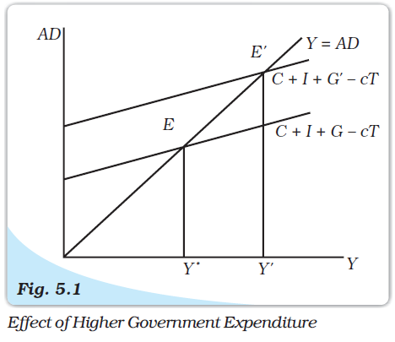
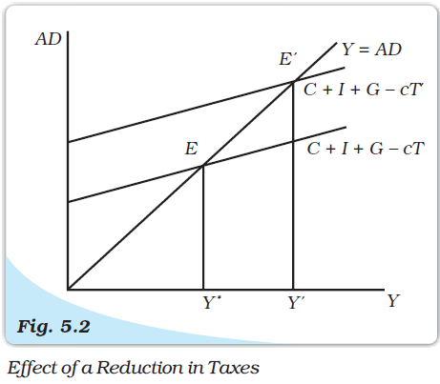
Solving for the equilibrium level of income, we get

Slide 55





The government expenditure multiplier is
The tax multiplier is given by
For an increase in government spending by 100, the equilibrium income will increase by 500
The tax multiplier is given by
A tax cut of 100 (ΔT= –100) will increase equilibrium income by 400

Slide 56
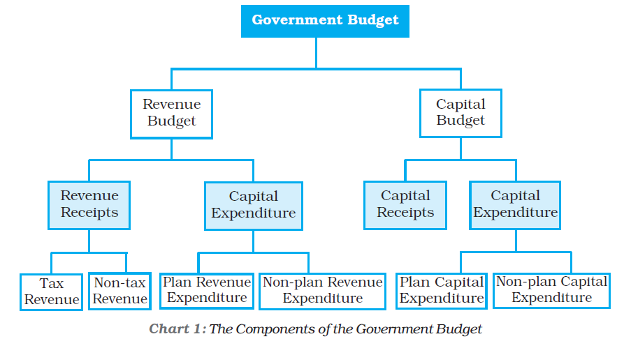

Slide 57
How to do inflation forecasting?
(1) Primary food articles: the first step is a forecast of primary food article prices because they are central and drivers are primarily supply side. The size and monthly distribution of rainfall during June-September are a key determinant of output and prices; global commodity prices also have influence with a lag on domestic prices. Ministry of Finance (Working Paper No. 1, 2011) and RBI (Working paper, Jan. 2012) papers both validate this; the latter found that an increase of 10 per cent in global non-fuel commodity prices increases headline inflation by 70-90 basis points in the same quarter.
(2) Food and primary article’s prices also tend to have a 'cost push' impact on manufacturing products. Wages and price expectations in a developing country tend to 'anchor' strongly around food prices. Therefore forecasts of food prices are essential not just in terms of their weight, but as an alternate sense of 'core' inflation.
(3) Forecasts of manufacturing inflation, the 'core' usually used in India by the RBI and others, can usefully incorporate three elements (a) expected food prices; (b) global raw material commodity prices; and (c) an index of demand conditions such as the index of industrial production (IIP) (suitably averaged to avoid high-frequency data noise).
(4) Needless to add, monetary and fiscal policies also impact on inflation although with substantial time-lags.
(5) All forecasts, especially near term, also benefit from and rely greatly on judgments. To quote from the US Fed Chairman, 'the forecasts of inflation…. that are provided to the Federal Open Market Committee are developed through an eclectic process that combines model-based projections, anecdotal and other "extra-model" information, and professional judgment. In short, for all the advances that have been made in modeling and statistical analysis, practical forecasting continues to involve art as well as science.'-Ben Bernanke (Inflation Forecasting, 10 July 2007)

Slide 58
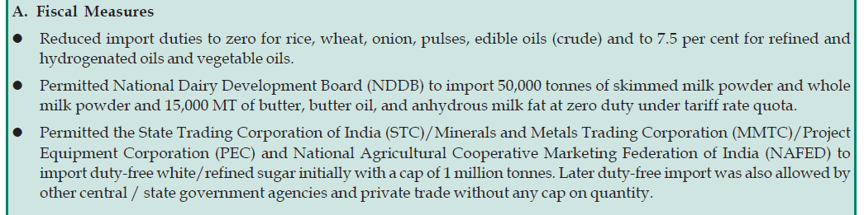
Measures to contain inflation

Slide 59
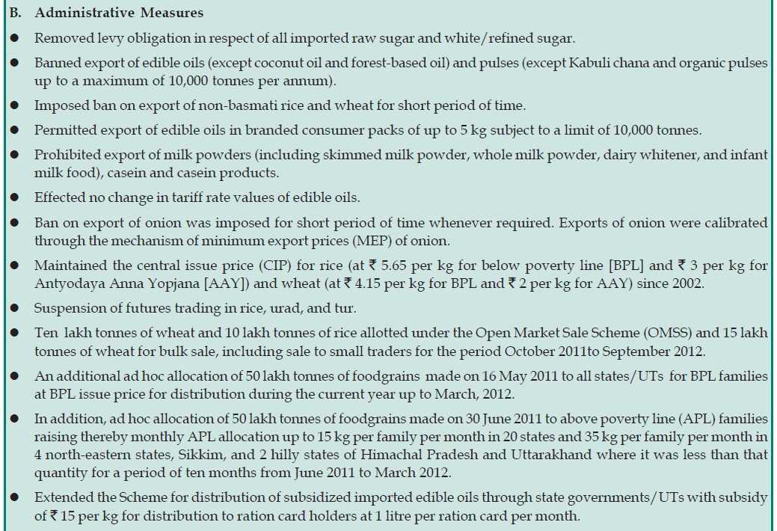

Slide 60
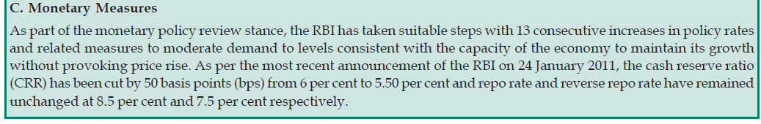

Slide 61
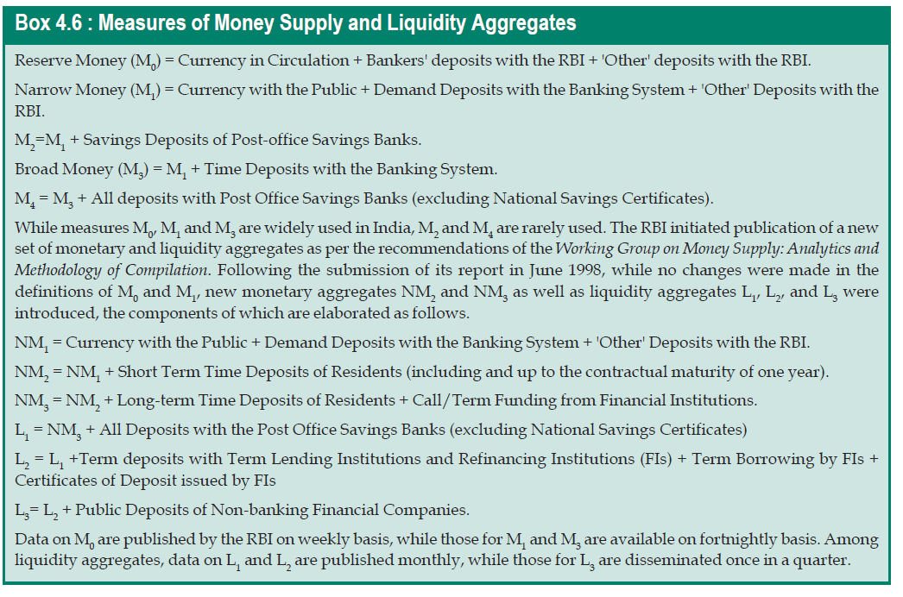

Slide 62

Thank y☺u
Pupils of Economics

